Slide 1
Machine Learning
BUAN 6341
Dr. Nassim Sohaee

Slide 2
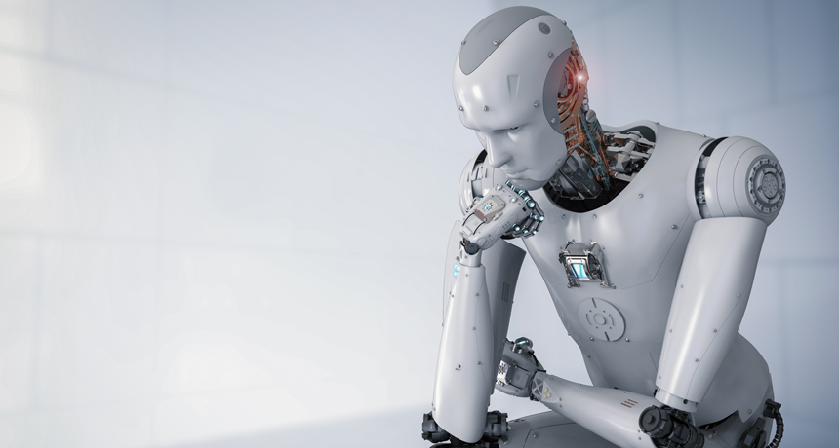
What is Machine Learning?

Slide 3
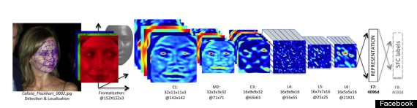
Facebook
Open your Facebook page
In your newsfeed can you see anything related to machine learning?
Can you point out some of them?
Try to upload a picture. Can you find more machine learning?
Facebook’s facial recognition (Huffington Post)

Slide 4
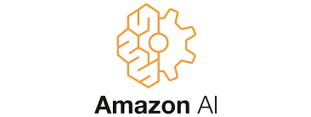
Amazon:
Open amazon page
Search for a machine learning book.
You will get a ranked list

Slide 5
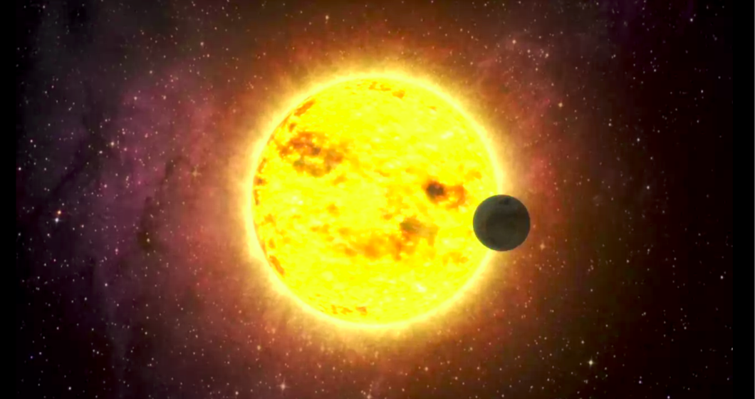
Science!
The higgs boson couldn’t have been found without machine learning.

Slide 6
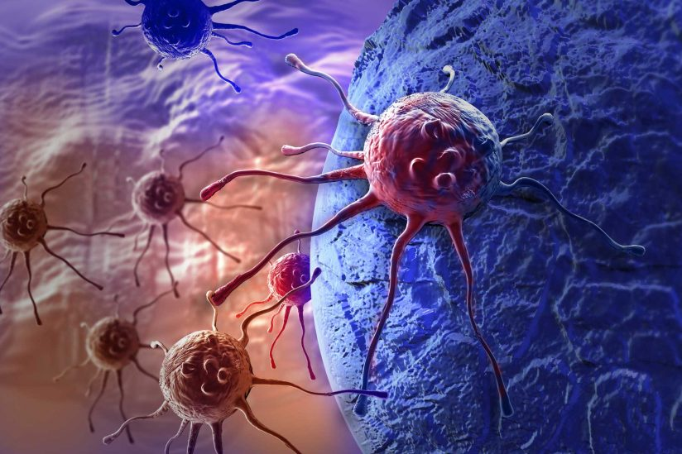
Science!
There is more and more personalized cancer treatment – via machine learning.
More medical diagnosis, and more drug discovery are using machine learning.

Slide 7
What is Machine Learning (ML)?
The study of computer programs (algorithms) that can learn by example
ML algorithms can generalize from existing examples of a task
– e.g. after seeing a training set of labeled images, an image classifier can figure out how to apply labels accurately to new, previously unseen images

Slide 8
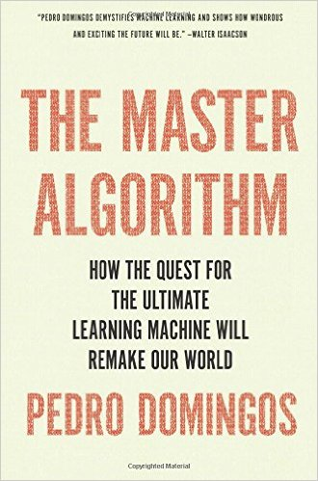
The Master Algorithm: How the Quest for the Ultimate Learning Machine Will Remake Our World

Slide 9
1936!
P = NP
Still an open problem
Possible solution: Machine learning

Slide 10
Introduction

Slide 11
Key types of Machine Learning problems
Supervised machine learning: Learn to predict target values from labelled data.
Classification (target values are discrete classes)
Regression (target values are continuous values)
Unsupervised machine learning: Find structure in unlabeled data
Find groups of similar instances in the data (clustering)
Finding unusual patterns (outlier detection)

Slide 12
Unsupervised learning: finding useful structure or knowledge in data when no labels are available
Finding clusters of similar users (clustering)
Detecting abnormal server access patterns (unsupervised outlier detection)

Slide 13
Data
Know your task
Know your data

Slide 14
A first Application

Slide 15

Classifying Iris species
Petal
Sepal

Slide 16
A Basic Machine Learning Workflow
Data Representation
Evaluation
Optimization

Slide 17
Splitting dataset
Training set:
Part of the dataset that is used to build a machine learning model
Test set:
The rest of the data to assess how well the model generalize to new data.
In sklearn contains a function that shuffles the dataset and split it to train and test datasets.
This function by default consider 75% of the dataset for training and the rest for test.

Slide 18
Step 1: Prepare dataset
Transform to numerical dataset
Similarity is measured by geometric distance
Address missing data
Data leakage
Address categorial data

Slide 19
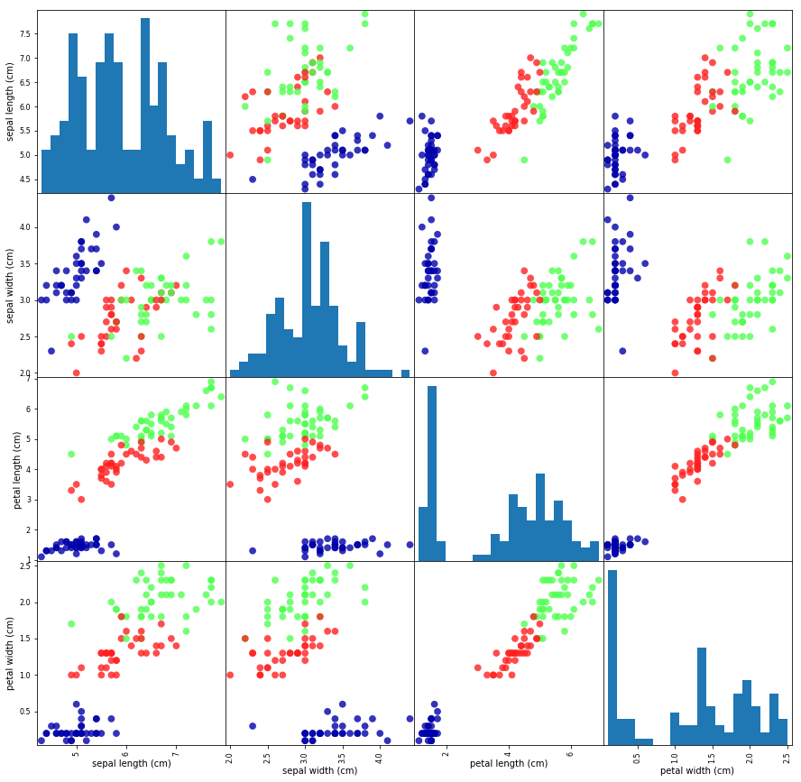
Visualize data

Slide 20
Missing data
Inspect input values
info()
describe()
<class 'pandas.core.frame.DataFrame'> RangeIndex: 112 entries, 0 to 111 Data columns (total 4 columns): sepal length (cm) 112 non-null float64
sepal width (cm) 112 non-null float64
petal length (cm) 112 non-null float64
petal width (cm) 112 non-null float64
dtypes: float64(4) memory usage: 3.6 KB

Slide 21
Data leakage
When the data you're using to train contains information about what you're trying to predict.
Obvious examples:
Including the label to be predicted as a feature
Including test data with training data

Slide 22
Step 2: Build a model
K Nearest Neighbors (KNN)
Example: 3NN
new observation
1
1
2
2
2

Slide 23
Build a model in sklearn
Instantiate the estimator
fit: Train the model on the training set
predict: predict the label of a new observation

Slide 24
Step 3: Evaluation
X_train, X_test, y_train, y_test = train_test_split(
iris_dataset['data'], iris_dataset['target'], random_state=0)
knn = KNeighborsClassifier(n_neighbors=1)
knn.fit(X_train, y_train)
print("Train set score: {:.2f}".format(knn.score(X_train, y_train)))
print("Test set score: {:.2f}".format(knn.score(X_test, y_test)))

Slide 25
Represent / Train / Evaluate / Refine Cycle

